Slide 1
Data and Excel basic
Bob Xie Sep 2020

Slide 2

What’s Data
Data is a set of values of qualitative or quantitative variables. An example of qualitative data would be an anthropologist's handwritten notes about his or her interviews with people of an Indigenous tribe. Pieces of data are individual pieces of information. While the concept of data is commonly associated with scientific research, data is collected by a huge range of organizations and institutions, including businesses (e.g., sales data, revenue, profits, stock price), governments (e.g., crime rates, unemployment rates, literacy rates) and non-governmental organizations (e.g., censuses of the number of homeless people by non-profit organizations).
Data is measured, collected and reported, and analyzed, whereupon it can be visualized using graphs, images or other analysis tools. Data as a general concept refers to the fact that some existing information or knowledge is represented or coded in some form suitable for better usage or processing. Raw data ("unprocessed data") is a collection of numbers or characters before it has been "cleaned" and corrected by researchers. Raw data needs to be corrected to remove outliers or obvious instrument or data entry errors (e.g., a thermometer reading from an outdoor Arctic location recording a tropical temperature). Data processing commonly occurs by stages, and the "processed data" from one stage may be considered the "raw data" of the next stage. Field data is raw data that is collected in an uncontrolled "in situ" environment. Experimental data is data that is generated within the context of a scientific investigation by observation and recording. Data has been described as the new oil of the digital economy.
From Wikipedia

Slide 3

What’s Data Analysis
Data analysis, also known as analysis of data or data analytics , is a process of inspecting, cleansing, transforming, and modeling data with the goal of discovering useful information, suggesting conclusions, and supporting decision-making. Data analysis has multiple facets and approaches, encompassing diverse techniques under a variety of names, in different business, science, and social science domains
From Wikipedia

Slide 4
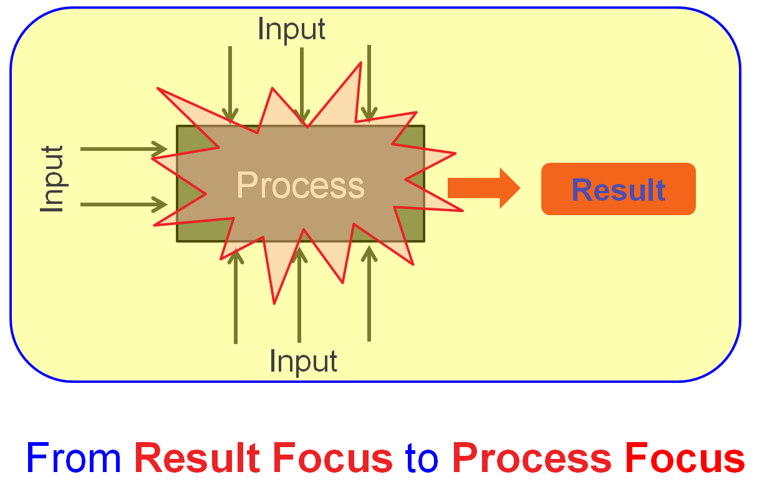
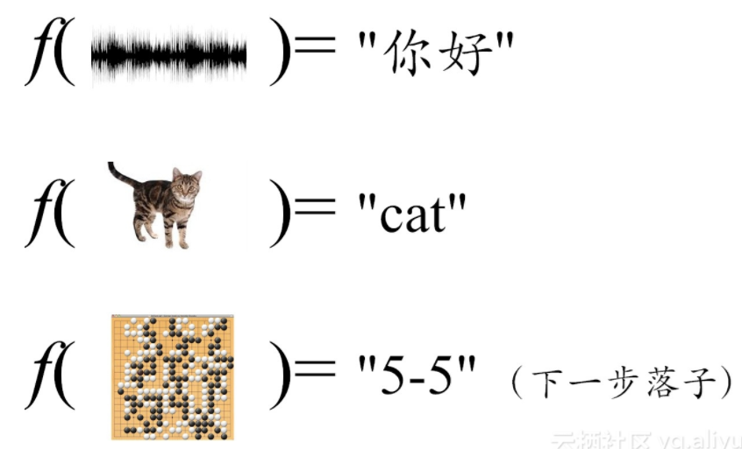
Why Data Analysis
Y = f (X)

Slide 5
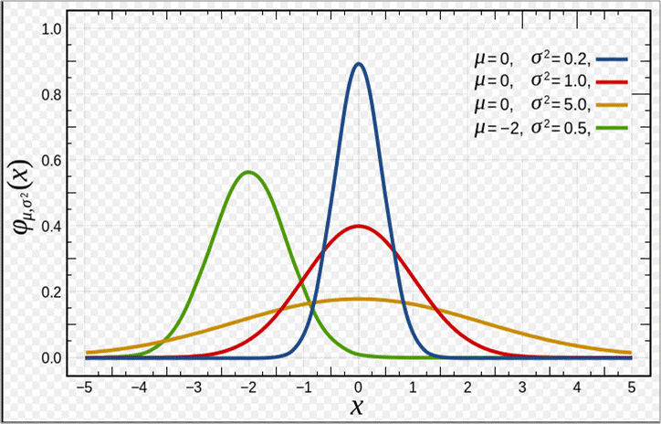
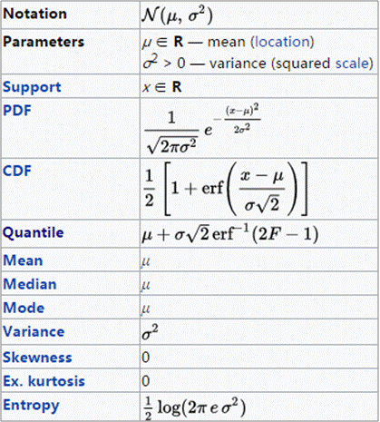
Data distribution _ Normal
Example: Length, weight, Voltage, Current .etc

Slide 6
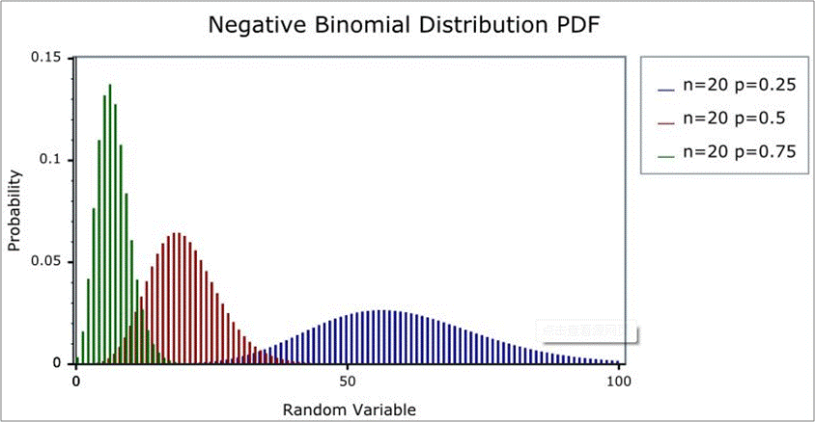
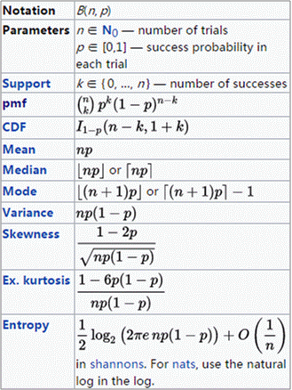
Data distribution _ Binomial
Example: IFIR, RA, LRR .etc

Slide 7
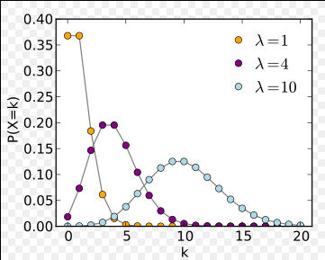
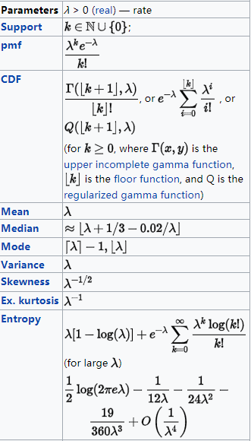
Data distribution _ Poisson
Example: Call in # /hr, Cosmetic defects .etc

Slide 8
Sampling VS Population
Sample
Population
????
Classical
Bayesian
Sample
Sampling
Population

Slide 9
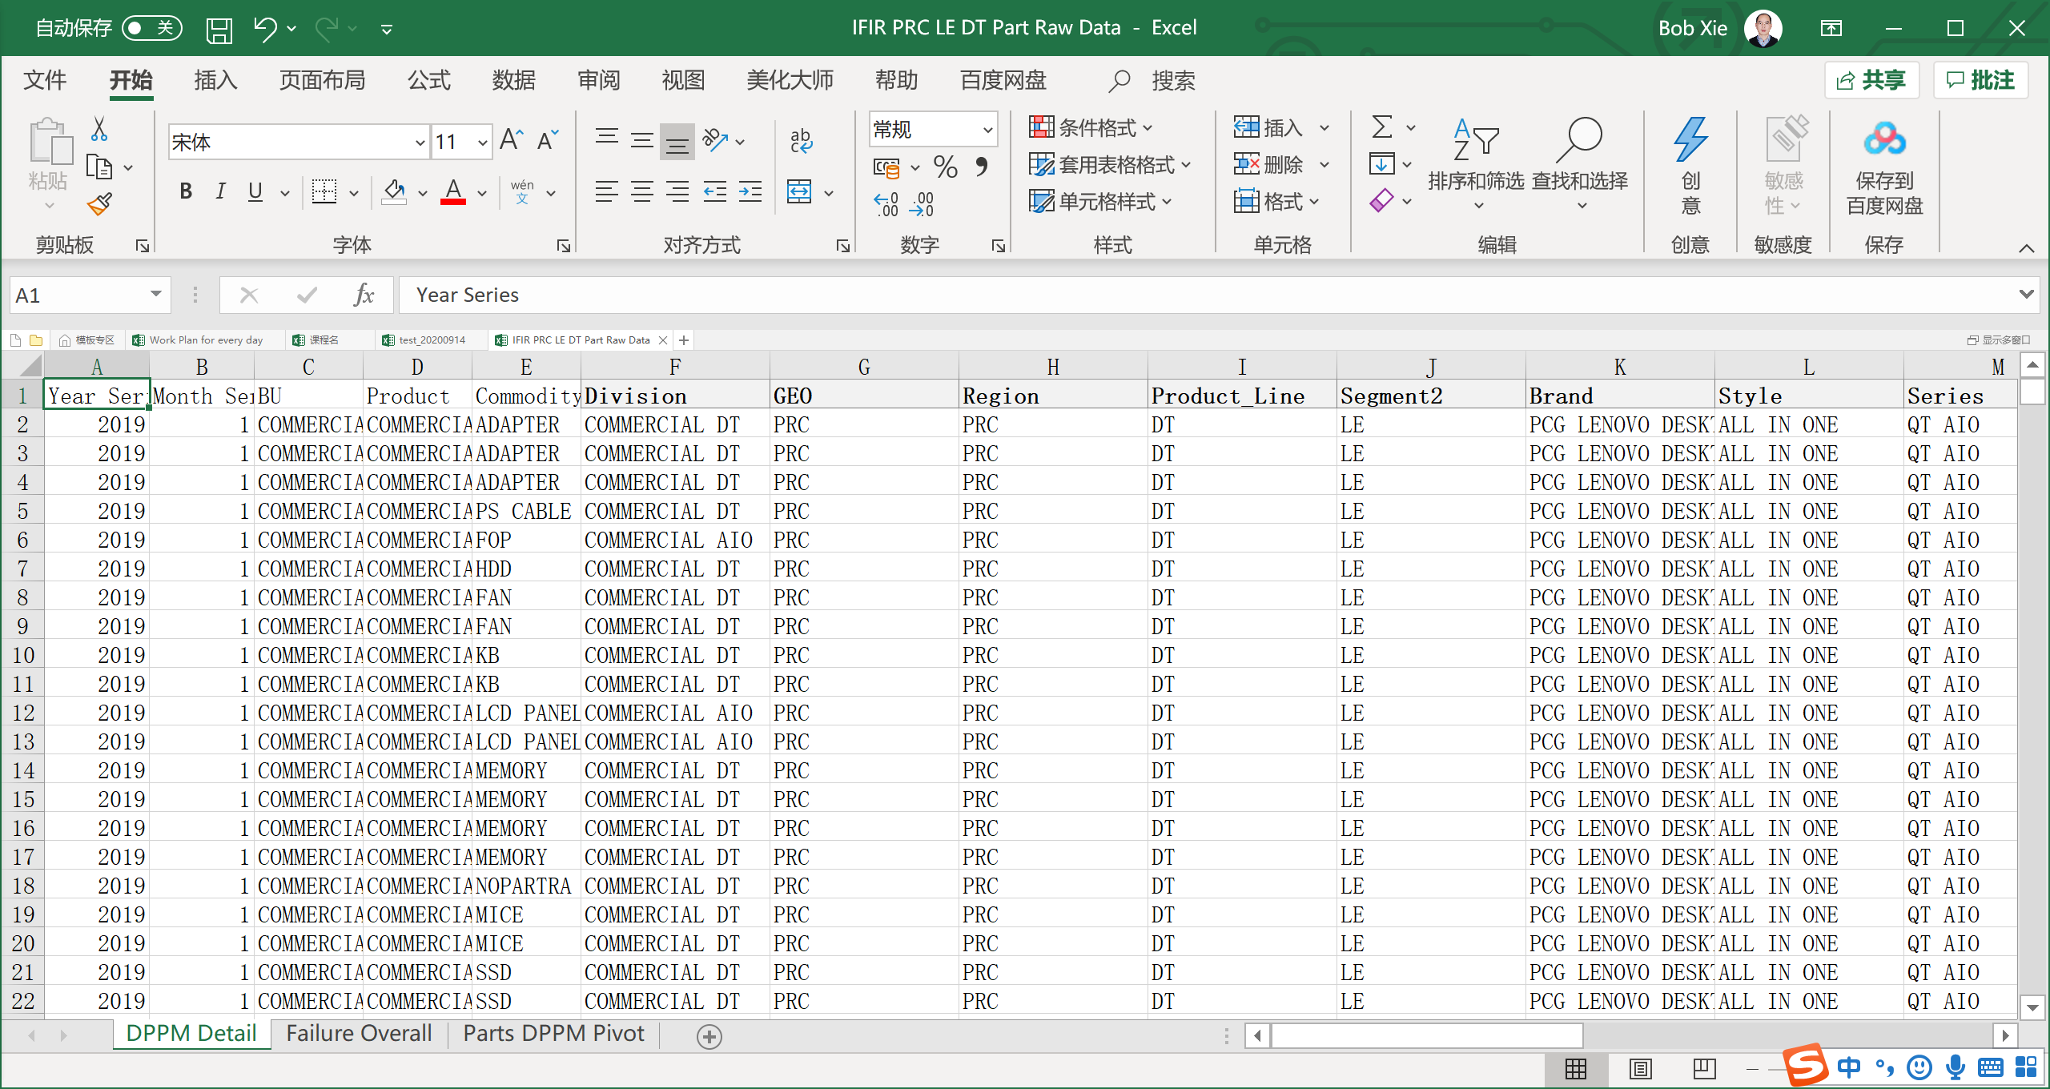
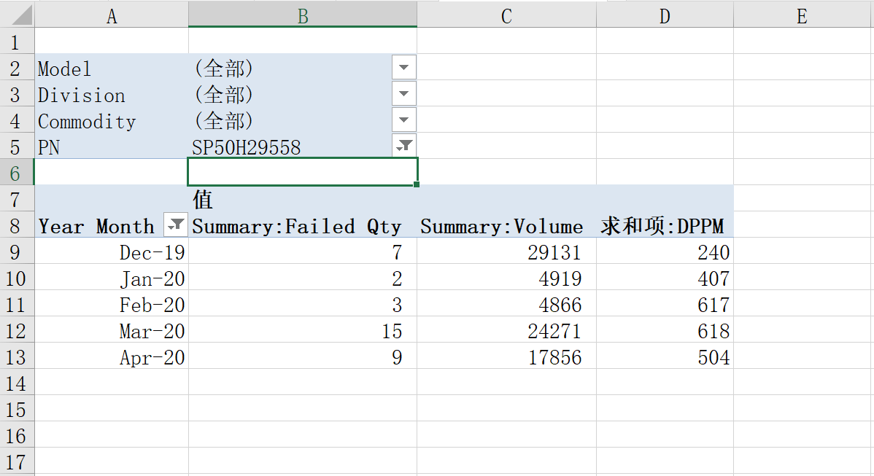
Excel Basic _ Pivot

Slide 10
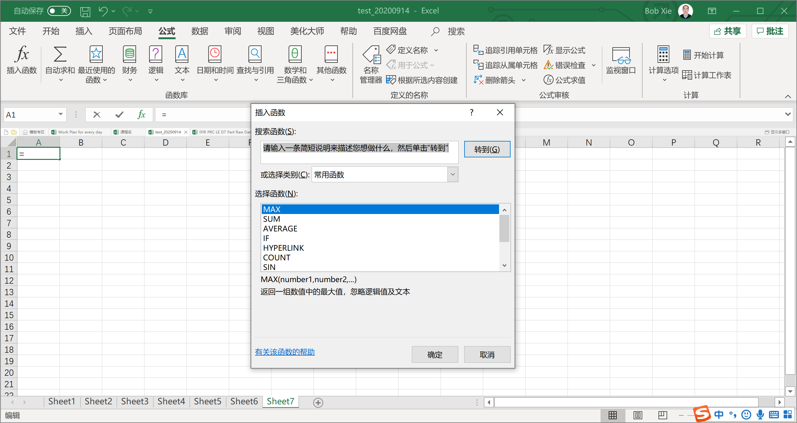
Excel Basic _ Function

Slide 11
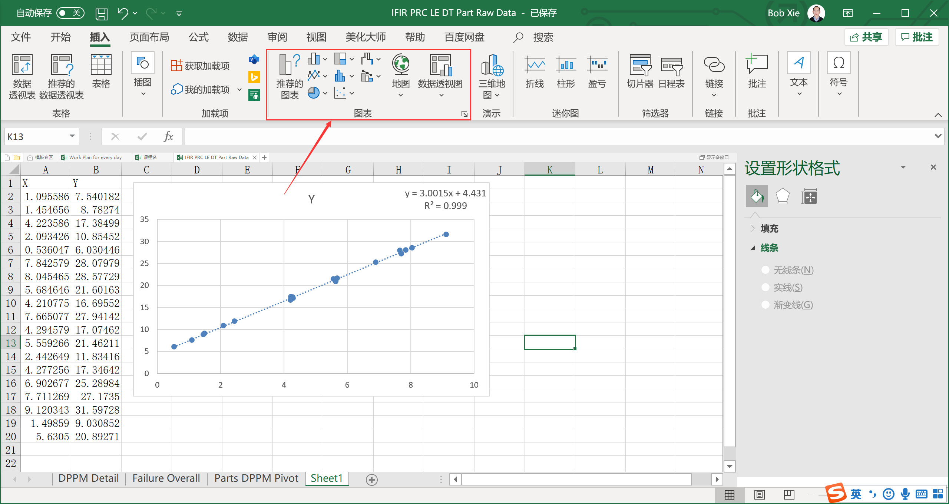
Excel Basic _ Charts

Slide 12
Home work
Use Excel to draw curve of F（X）= X^2+2*X+1;
Figure out how to set up the Anaconda for Python;

Slide 13


Author information
Bob Xie: Lenovo Senior SQE
If you interesting about Data analysis, can follow my column and WeChat
WeChat
column

